Slide 1
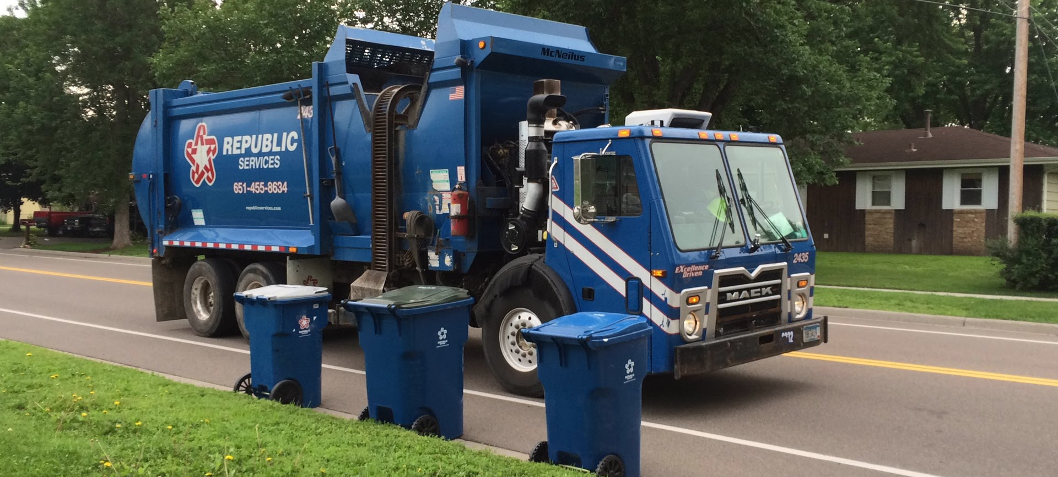
SOLID WASTE FUND

Slide 2
2019 Solid Waste Budget

